Slide 1
Predicting Prison Recidivism with Supervised Learning Models
Max Barry
February 13, 2019

Slide 2
Incarcerated
Population of US
Population Metro Chicago
Population of Portland
2.720 million
2.298 million
648,000
650,000 p/yr
2 out of 3 of whom will go back to prison
Notes:
What is recidivism? Re-arrest after release.
$100 per day per inmate
Huge population
China, Brazil, Russia

Slide 3
Iowa Data Set
26,020
rows of data
Notes:
Why Iowa?
Really good data set where each row was a feature.
26,020 records reduced to 24,150
From a three year recidivism study from 2013-18
Dropped rows with null:
Best performing dataframe did not include year released or target population flag.

Slide 4
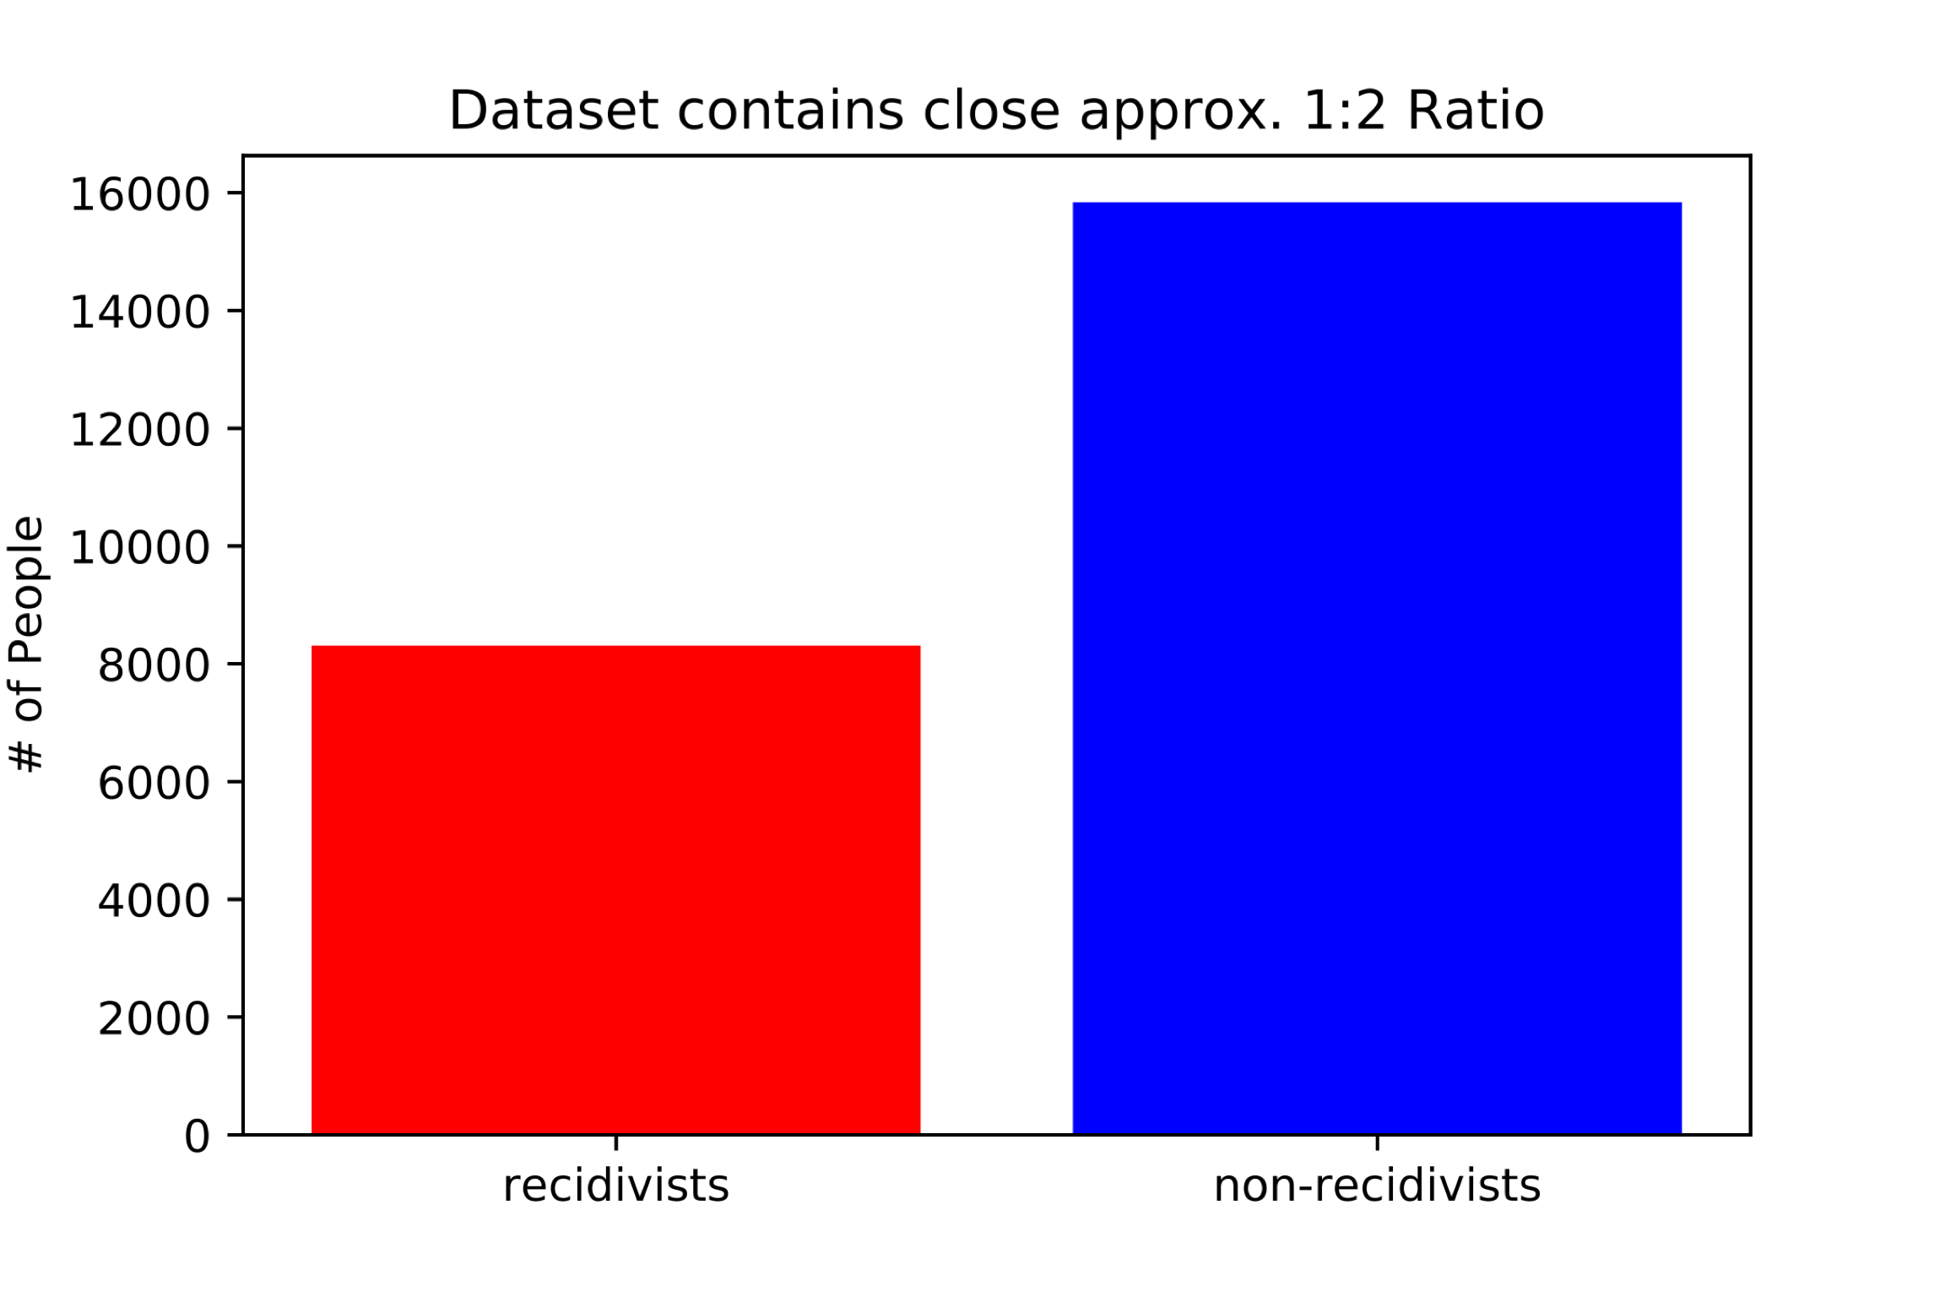
Recidivism in the Dataset
Notes:
24150 Individual Records
1:2 ratio. Nationally, the ratio is generally cited to be 2:1.

Slide 5
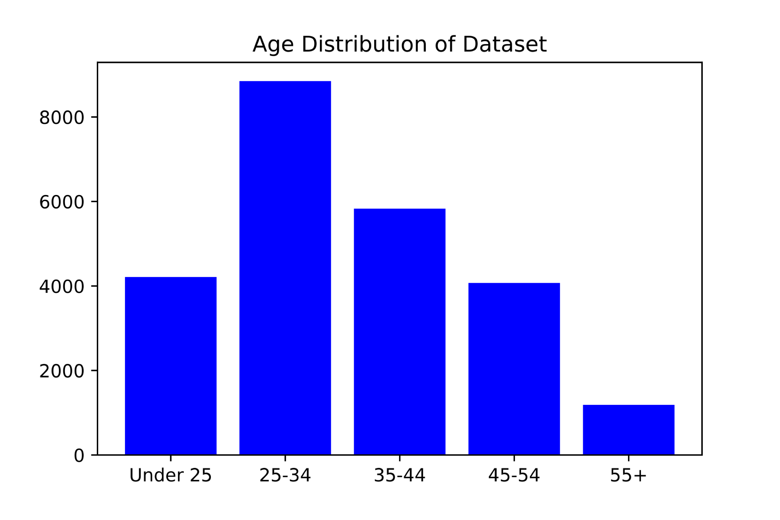
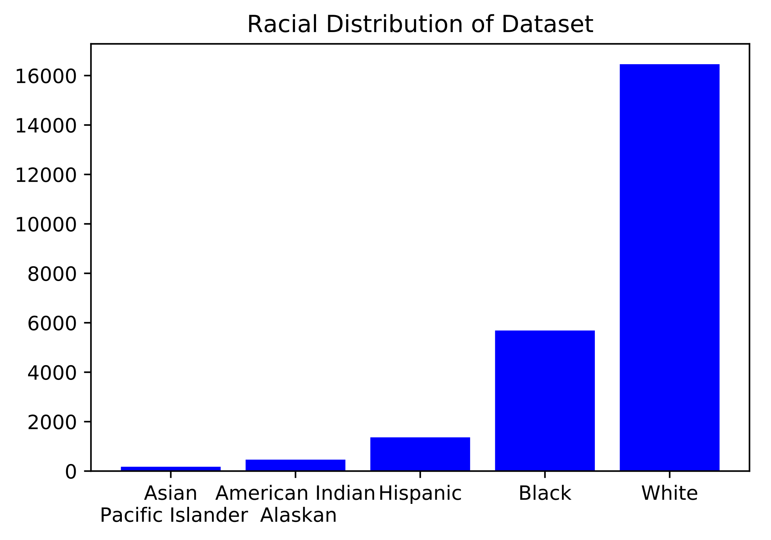
Age and Race Distribution
Notes:
Offense Class, Type, Subtype, Target Population, Type of release
Large population of white prisoners.
Iowa is not very diverse. Nationally, the breakdown for men is about 37% black, 32% white, and 22% Hispanic.

Slide 6
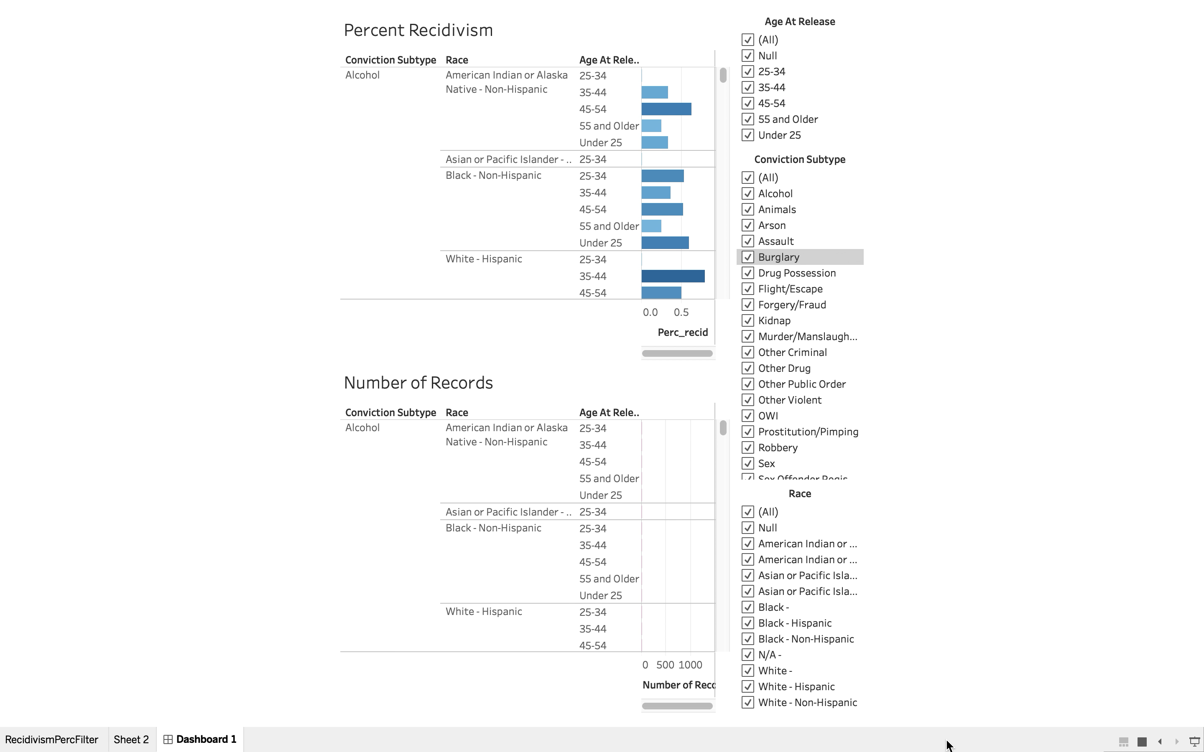
Tableau Figure

Slide 7
Best Performing Models
Random Forest
Max Depth 8
roc_auc = .654
Logistic
C = 1.21 roc_auc = .669
Naïve-Bayes
(Bernouli)
roc_auc = .646

Slide 8
Notes:
With a .5 probability classifier, false positives are relatively low. False positives are very important, and I would tune the threshold to make less false positives.
Tune the threshold to .4 to account for less false negatives.

Slide 9
Most Important Features
Race
Age
Offense Subtype
Hispanic
Black
White
55 and older
25-34
45-54
Murder
Assault
Sex
Notes:
Feature importance negatively correlated
with true recidivism rates
Total Hispanic Population Count in Test Set 281 False positives for Hispanic Population 27 False negatives for Hispanic Population 28
Total 55 and older Population Count in Test Set 230 False positives for 55 and older population 10 False negatives for 55 and older population 47
Total Convicted Murderer Population Count in Test Set 67 False positive Convicted Murderer and older population 0 False negative Convicted Murderer and older population 12

Slide 10
Conclusions
Increase attention on:
Violent offenders
Fifth Judicial District
Black and white populations
Ages 25-34 and 45-54

Slide 11
Future Work
More data from different states
Look at the effect of prison programs: education, art, re-entry assistance
Compare private prison

Slide 12
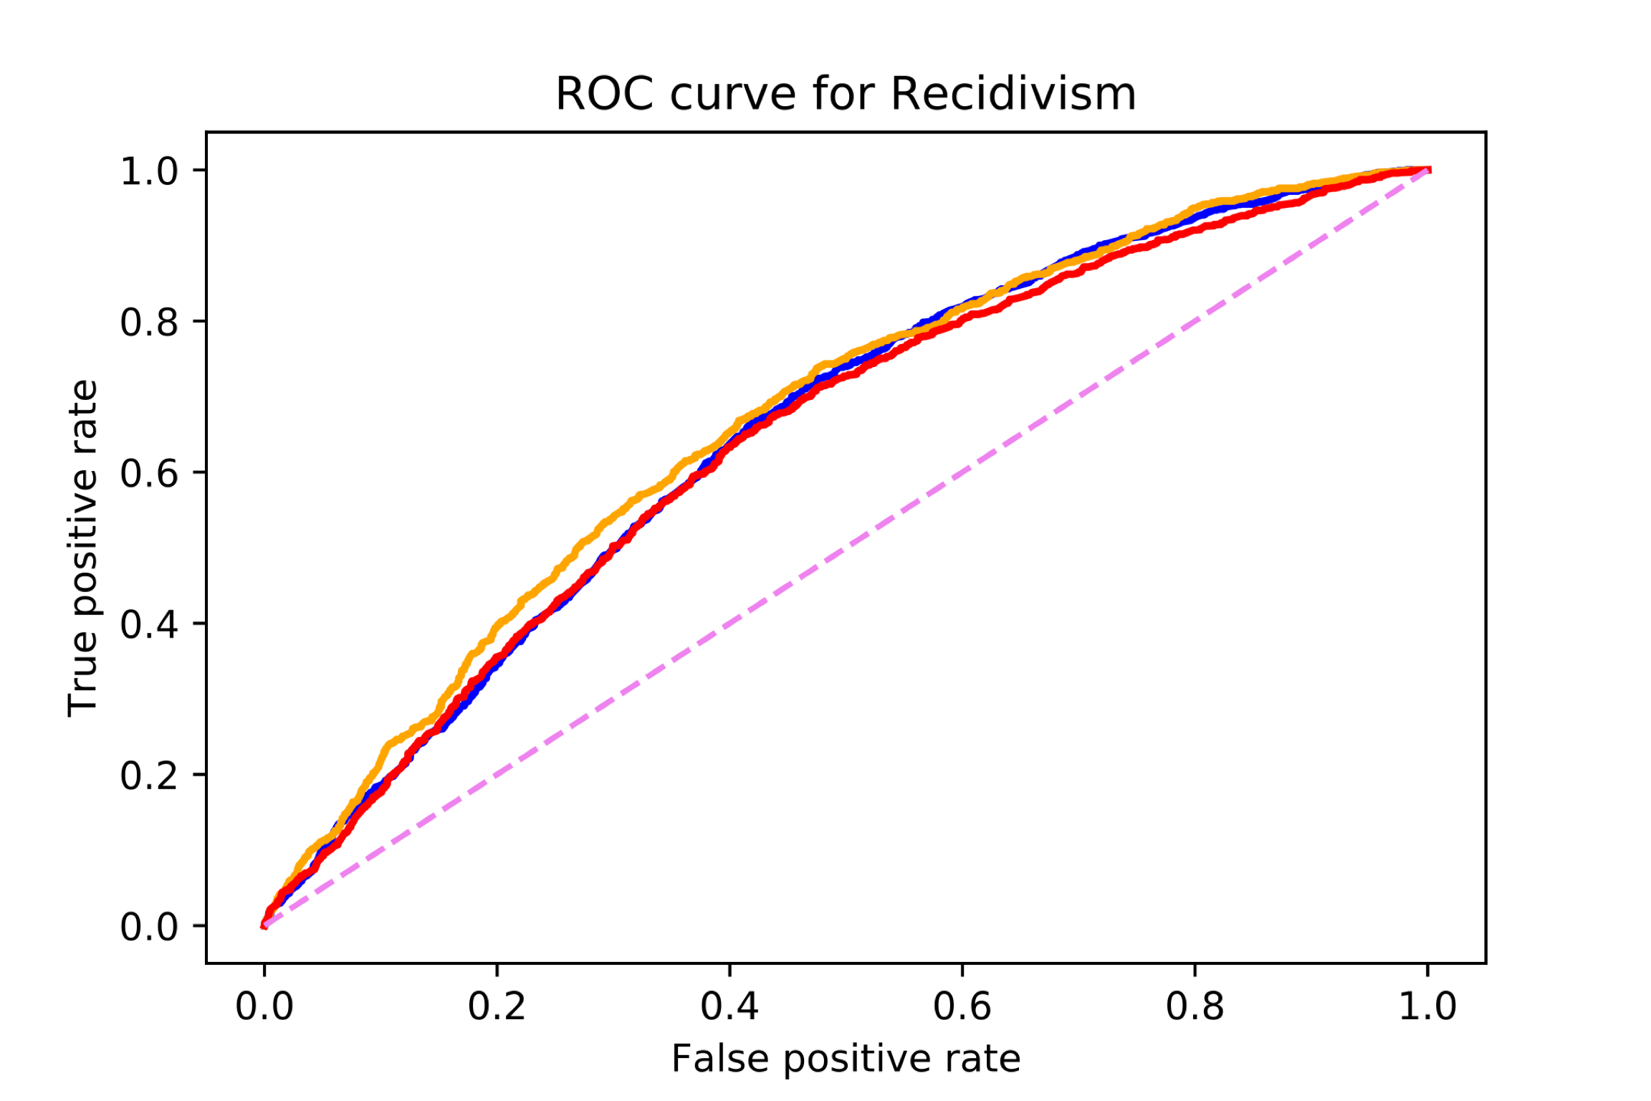
Appendix

Slide 13
Appendix
('supervising_district_ISC', 0.025530299186625922), ('supervising_district_Interstate Compact', 0.027550217012626166), ('age_at_release_55 and Older', 0.03266244078241629), ('race_White - Hispanic', 0.03363890971559354), ('convicting_type_Violent', 0.03479034565604832), ('release_type_Discharged – End of Sentence',0.0467081817202875), ('supervising_district_5JD', 0.05344265065566477), ('target_pop_flag', 0.09402810270761891), ('supervising_district_None-Discharged', 0.24566992706813906)]
conviction_subtype_Murder/Manslaughter 0.01615808716695809 conviction_subtype_Assault 0.01311890440659245 conviction_subtype_Sex 0.011277773505339381 conviction_subtype_OWI 0.009323779685884775 conviction_subtype_Burglary 0.008065651912288505 conviction_subtype_Other Criminal 0.006954823083670453 conviction_subtype_Kidnap 0.004488567654634593 conviction_subtype_Alcohol 0.004456767538388503 conviction_subtype_Traffic 0.00432762834360309 conviction_subtype_Other Violent 0.004095889550283228
Notes:
U.S. has a prison prison population rate of 655 prisoners per 100000, http://www.prisonstudies.org/sites/default/files/resources/downloads/wppl_12.pdf
World prison population rate is 145 per 100,000, http://www.prisonstudies.org/sites/default/files/resources/downloads/wppl_12.pdf

